Slide 1

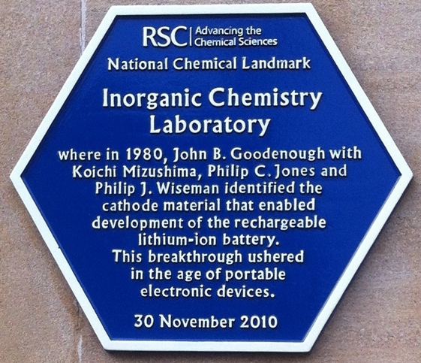

Battery Research at Oxford
David Howey
david.howey@eng.ox.ac.uk

Slide 2
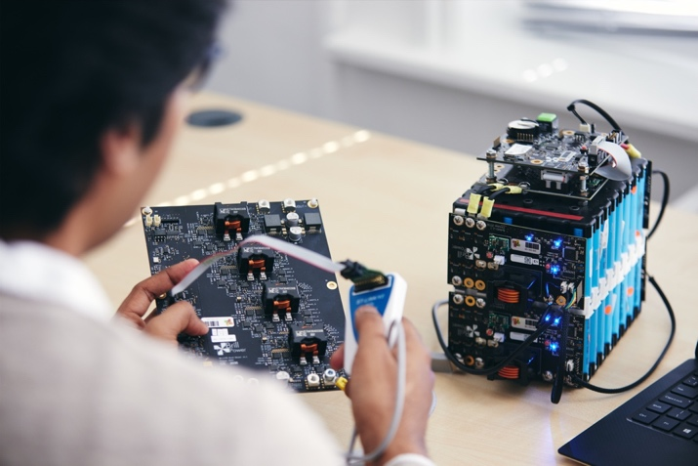

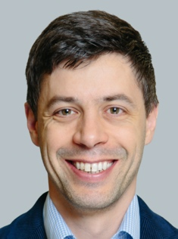
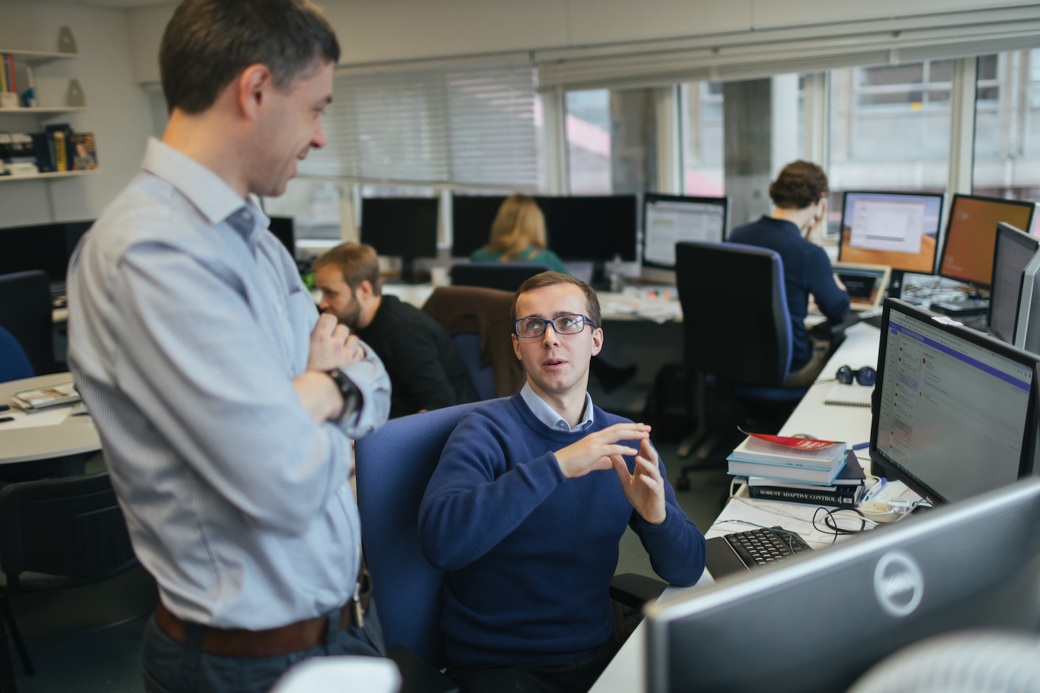




Introductions
Prof David Howey
Battery modelling, control and diagnostics
Energy storage systems, for electric vehicles as well as grid and off-grid power systems
Professor of Engineering Science and Tutorial Fellow at the University of Oxford since 2011
Battery Intelligence Lab - howey.eng.ox.ac.uk
Battery lifetime, degradation and thermal modelling
Lithium-ion, flow batteries, solar-battery off-grid systems
Gaussian process regression, machine learning, control algorithms
Software:
SLIDE for battery cell and pack simulation (C++)
Galvanalyser for storing battery cycling data

Slide 3
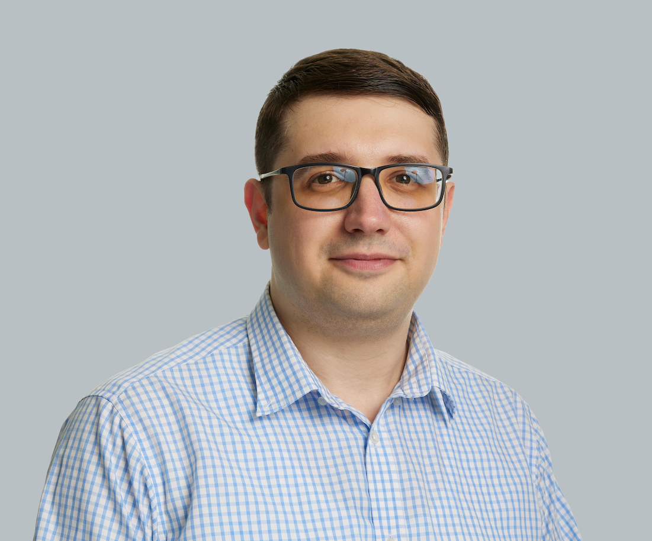
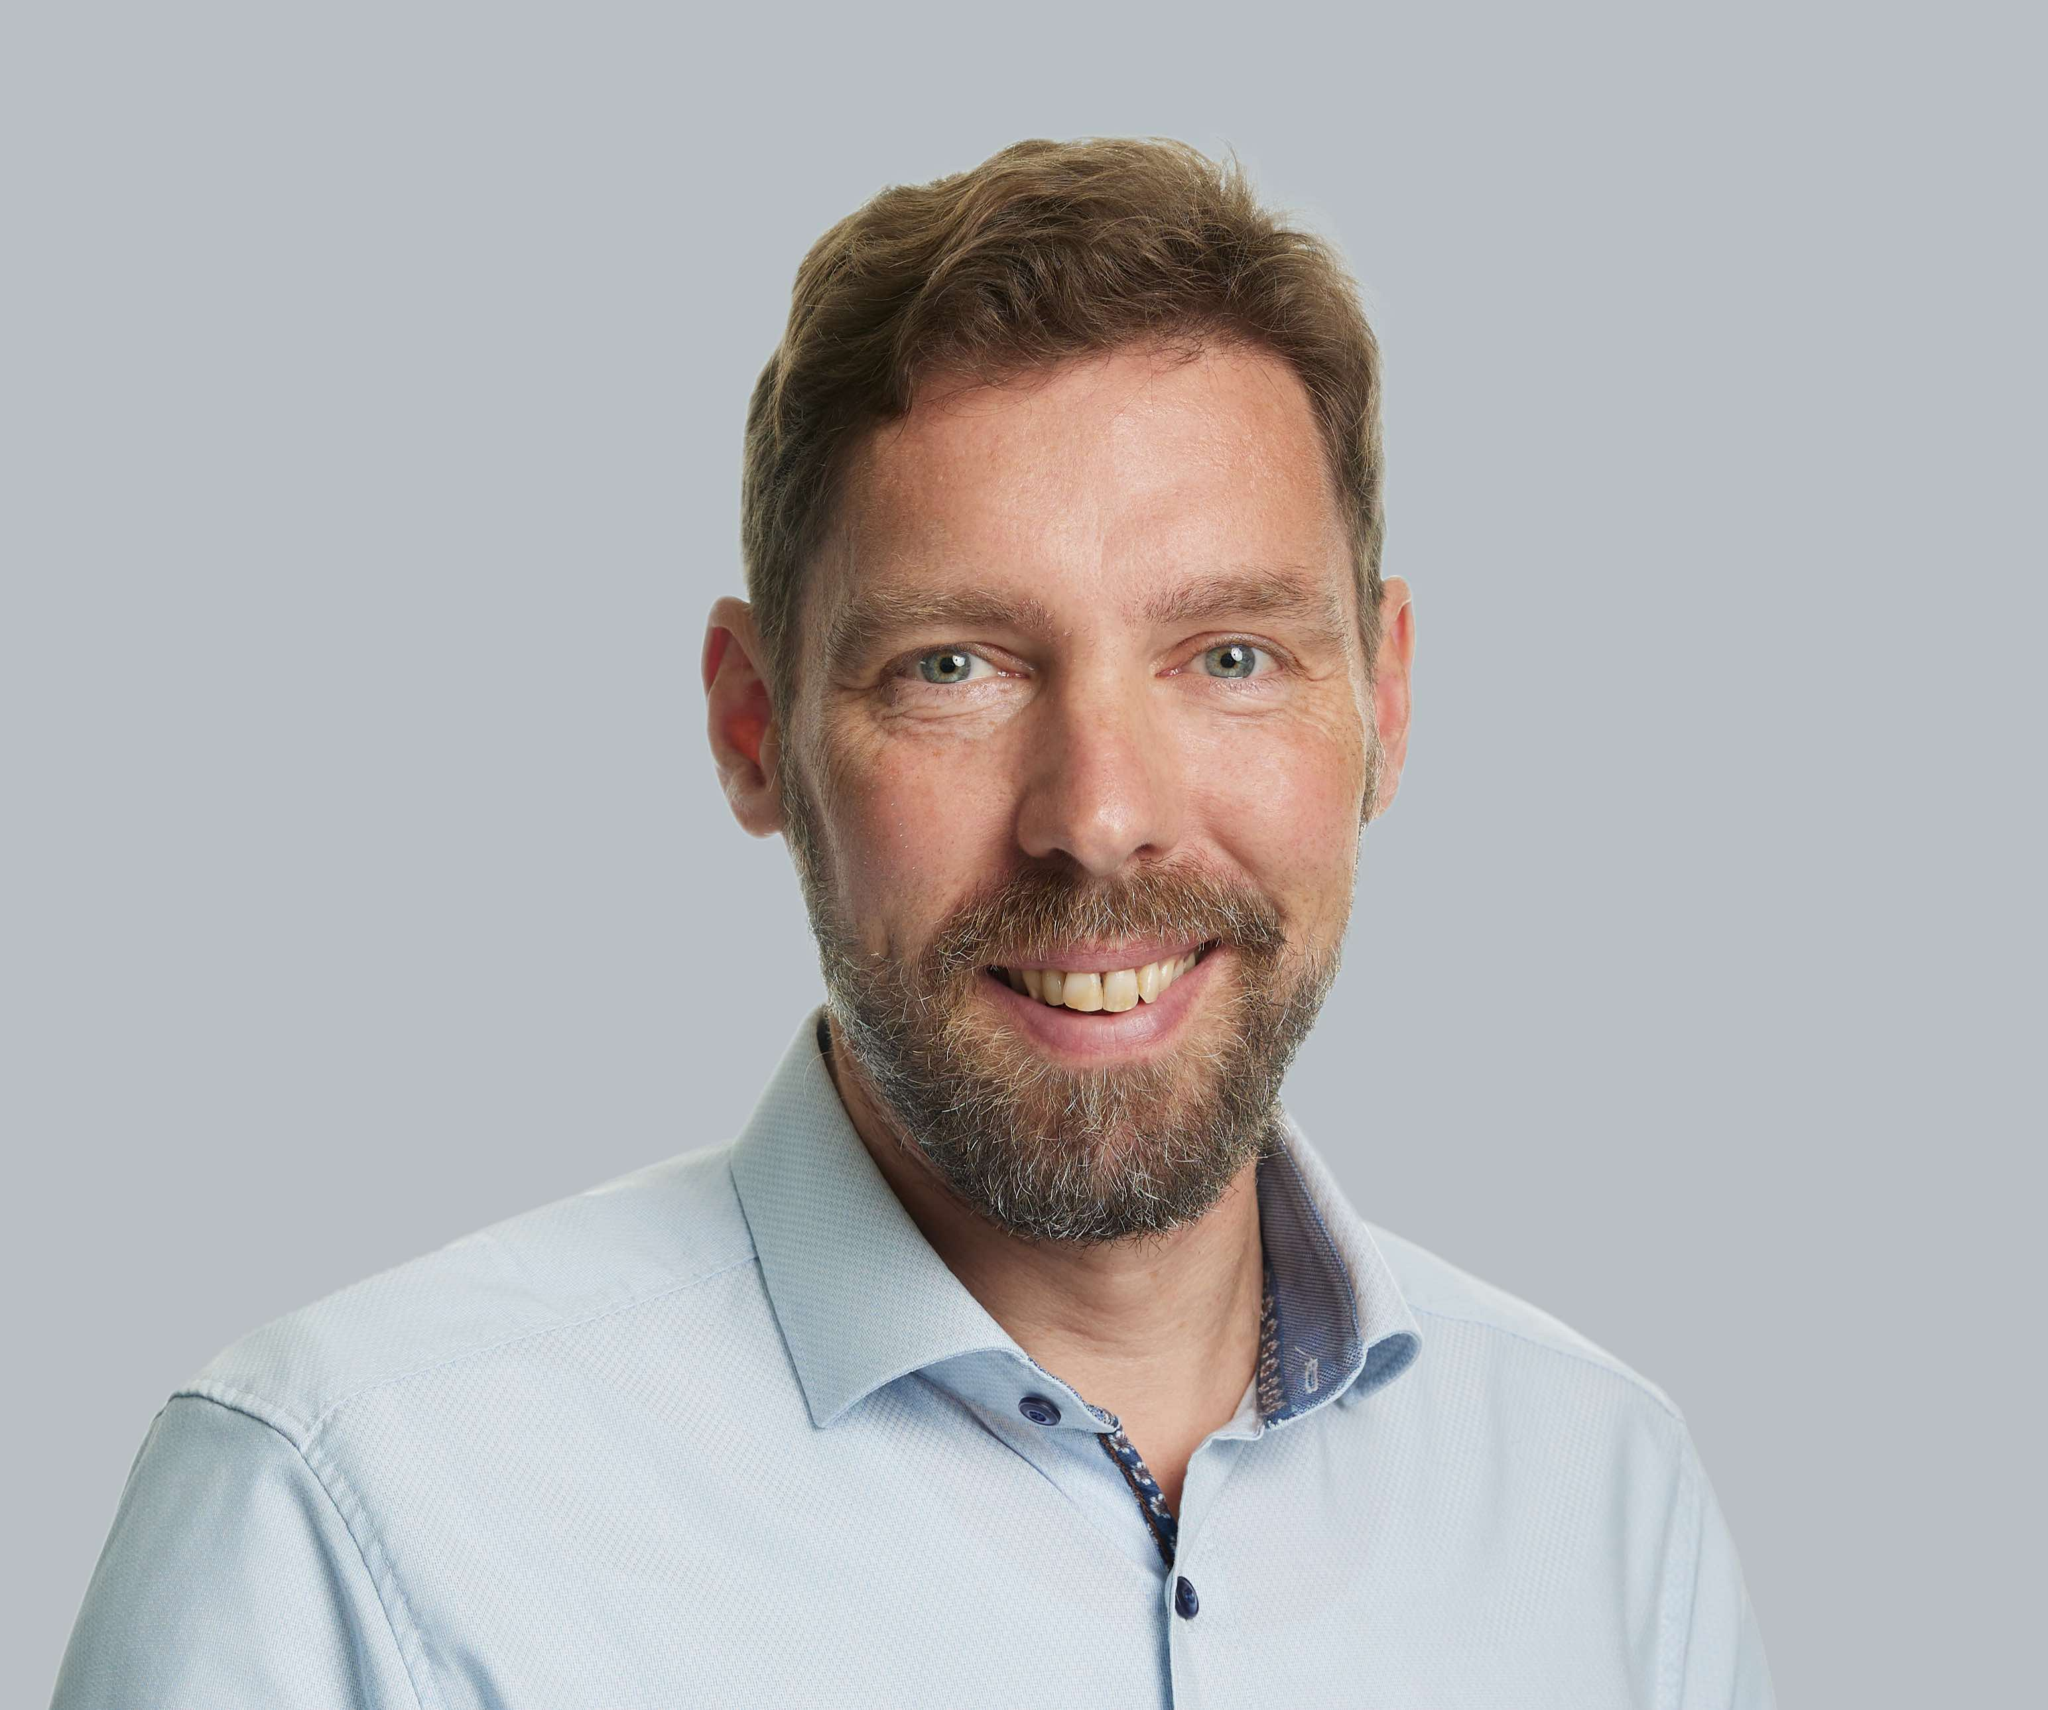
Phil Grunewald
Volkan Kumtepeli
Interests:
Optimisation
Mathematical modelling
Control theory
Open-source software
Interests:
Demand side flexibility
Time series data and clustering
Real-world data collection
Open access tools
Background:
2010 – 15 | BSc in electrical (power) engineering at Yildiz Technical University, Istanbul, Turkey
2015 – 20 | SINGA funded PhD at Nanyang Technological University on ageing-aware battery dispatch optimisation for grid-scale Li-ion batteries
2021 – | PDRA at Battery Intelligence Lab, Oxford
Background:
1999 – 08 | Laser engineer (semiconductor and PV industry)
2009 – 12 | UKERC funded PhD at Imperial on the future role of grid storage (before it was popular!)
2015 – 21 | EPSRC Fellow on time-use and energy data
2023 – 28 | Oxford PI for EDOL setting up UK demand observatory and laboratories

Slide 4
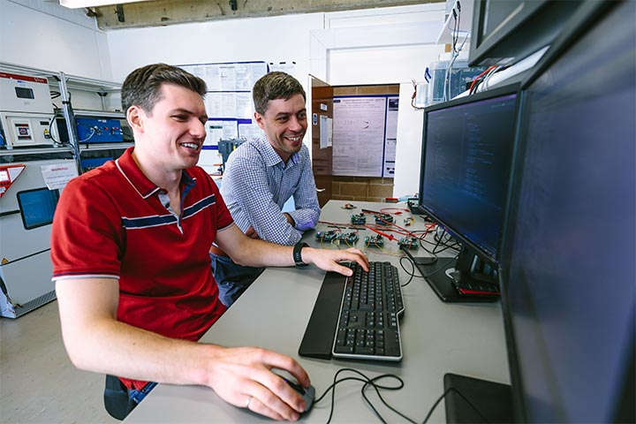
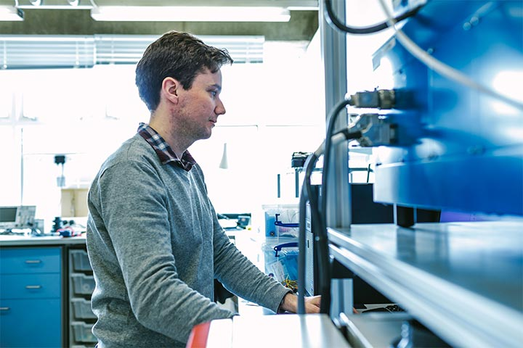


Key Oxford numbers (approximately!)
Personnel
25+ Professors/Associate Professors engaged in some form of battery research (including Bruce, Grant, Pasta – materials dept.; Monroe, Howey – engineering)
50+ Post-docs full time on battery research
80+ PhD students in battery-related research
Funding / Space
£50M Ongoing project portfolio
£15M Annual research value
~1000 m² labs aggregate; wide range of equipment
Papers / Impact
150+ new papers per year published on battery-related topics
~10,000-15,000 citations per year, collectively across key academics
Examples of licensing activities:
Battery health monitoring software
Advanced fluoride-based materials for Li-ion
Sprayed graded electrodes
Spin-out company: Brill Power Ltd. (BMS)

Slide 5


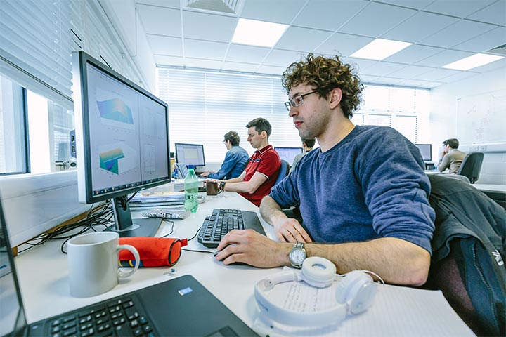
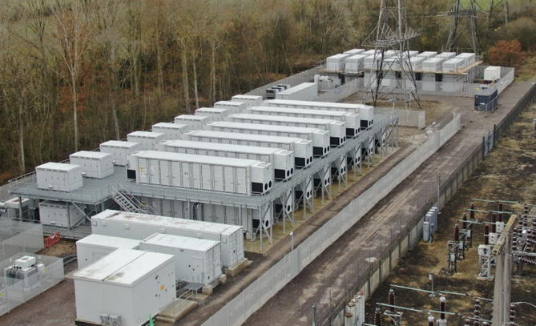
Key projects (focus: models, data)
Faraday Institution Multiscale Modelling Project
Led by Prof Greg Offer (Imperial College)
£15M, 2018-2023 (currently looking at 2023+)
Energy Superhub Oxford
£40M, industry-led (£10M govt funding)
Transmission-connected 50 MW(h) Li-ion / flow battery
10 MW connection to EV chargers
Data-driven exploration of CO2 impact of grid energy storage
£1M, 2-year project
Transmission grid + economic dispatch model
Collaboration grid/market + battery researchers
Main industry links
EDF/Pivot Power, BBOXX, Siemens/Conti, JLR, Rimac, Delta-Cosworth
Please don’t circulate these slides without permission

